Slide 1
Spring Boot SSL [https]

Slide 2
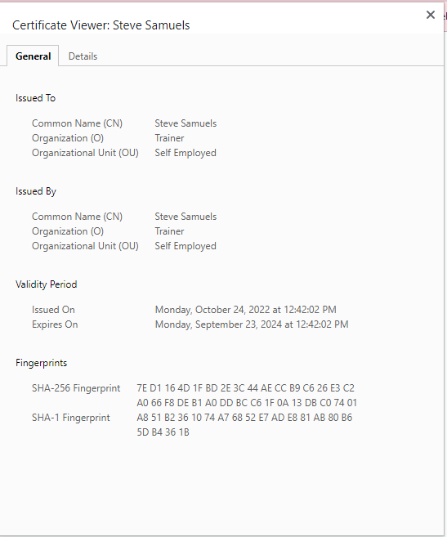

Slide 3
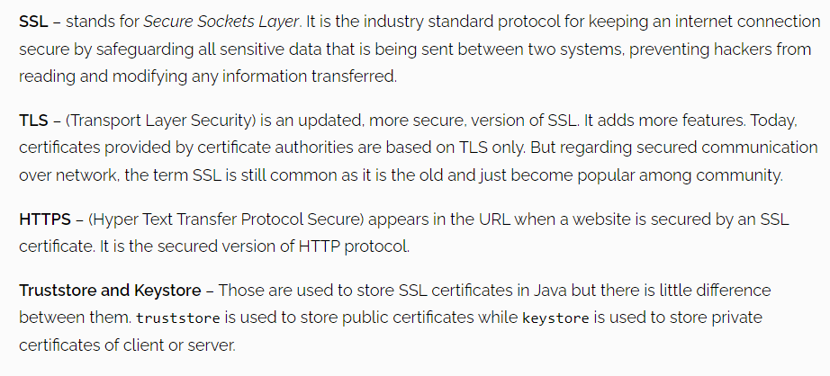
Terminology

Slide 4
Create your own self signed SSL certificate
Two options –
to create a self-signed certificate
ex: keytool -genkey -alias selfsigned_localhost_sslserver -keyalg RSA -keysize 2048 -validity 700 -keypass changeit -storepass changeit -keystore ssl-server.jks
to obtain SSL certificate from certification authority(CA) we call it CA certificate.

Slide 5
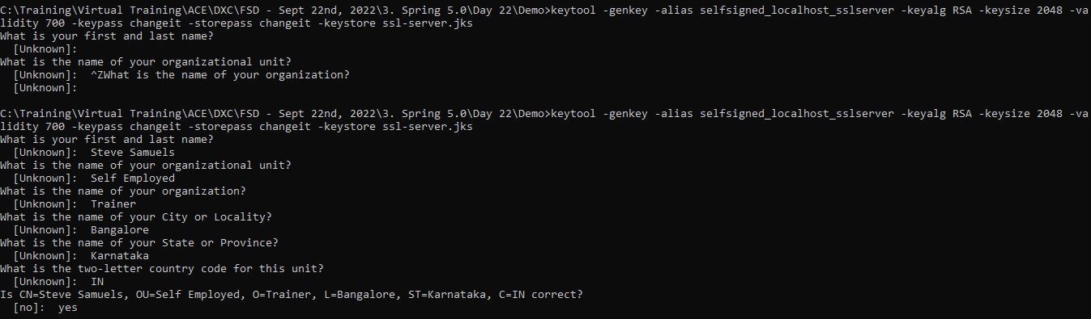

Slide 6
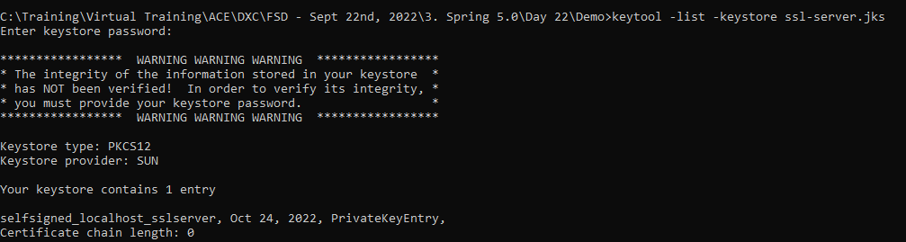

Slide 7

Create Spring-boot project and configure SSL
Assisted Practice
Generate spring boot project
Add REST endpoint
Spring Boot SSL Configuration
Redirect HTTP requests to HTTPS

Slide 8

Run Application and Test

Slide 9

Enable HTTPS in spring boot application
Create self signed SSL certificate
Redirect HTTP traffic to HTTPS
Summary

